Slide 1
Chapter 3
Data Resource Management

Slide 2
Fundamental Data Concepts
Character: single alphabetic, numeric or other symbol
Field or data item: a grouping of related characters
  Represents an attribute (a characteristic or quality) of some entity (object, person, place or event)
  Example: salary
Record: grouping of all the fields used to describe the attributes of an entity
  Example: payroll record with name, SSN and rate of pay

Slide 3
Fundamental Data Concepts
File or table: a group of related records
Database: an integrated collection of logically related data elements

Slide 4
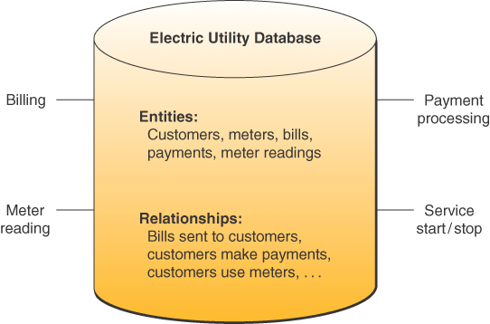
Electric Utility Database
Source: Adapted from Michael V. Mannino, Database Application Development and Design
(Burr Ridge, IL: McGraw-Hill/Irwin, 2001), p. 6.

Slide 5
Database Structures
Hierarchical
Network
Relational
Object-oriented
Multidimensional

Slide 6
Hierarchical Structure
Early DBMS structure
Records arranged in tree-like structure
Relationships are one-to-many
Notes:
Access data elements by moving progressively downward from the root and along the branches of the tree

Slide 7
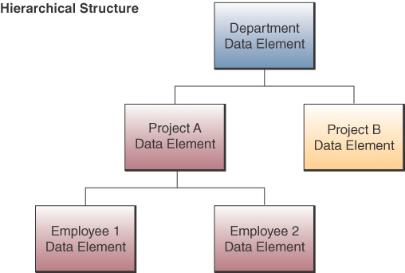
Hierarchical Structure

Slide 8
Network Structure
Used in some mainframe DBMS packages
Many-to-many relationships
Notes:
Any data element can be related to any number of other data elements

Slide 9
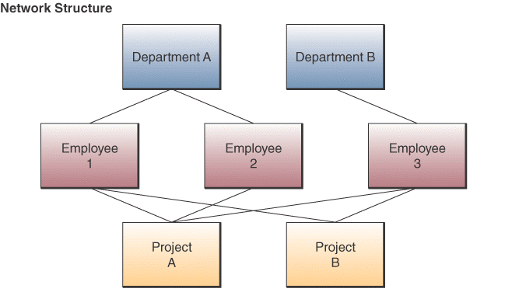
Network Structure

Slide 10
Relational Structure
Most widely used structure
Data elements are viewed as being stored in tables
Row represents record
Column represents field
Can relate data in one file with data in another file if both files share a common data element

Slide 11
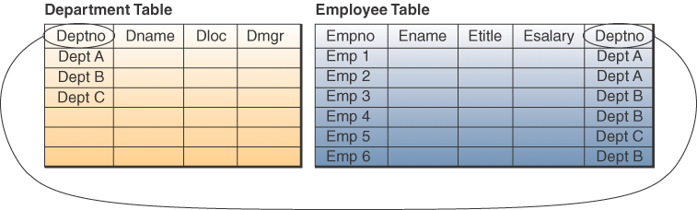
Relational Structure

Slide 12
Relational Operations
Select:
  Create a subset of records that meet a stated criterion
  Example, select employees who make more than $30,000
Join
  Combine two or more tables temporarily
  Looks like one big table
Project
  Create a subset of columns in a table
Notes:
Three basic operations on relational databases

Slide 13
Multidimensional Structure
Variation of relational model
Uses multidimensional structures to organize data
Data elements are viewed as being in cubes
Popular for analytical databases that support Online Analytical Processing (OLAP)
Notes:
OLAP is used for answers to complex business queries, discussed in detail in chapter 9

Slide 14
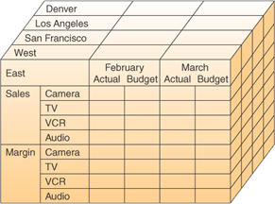
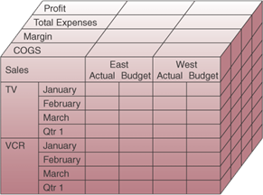
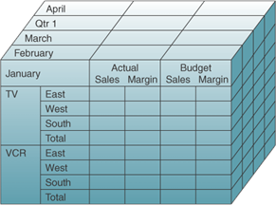
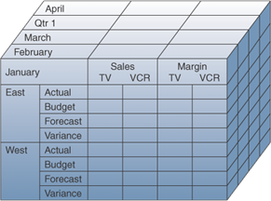
Multidimensional Model

Slide 15
Object-oriented Structure
Object consists of
  Data values describing the attributes of an entity
  Operations that can be performed on the data
Encapsulation:
  Combine data and operations
Inheritance:
  New objects can be created by replicated some or all of the characteristics of parent objects

Slide 16
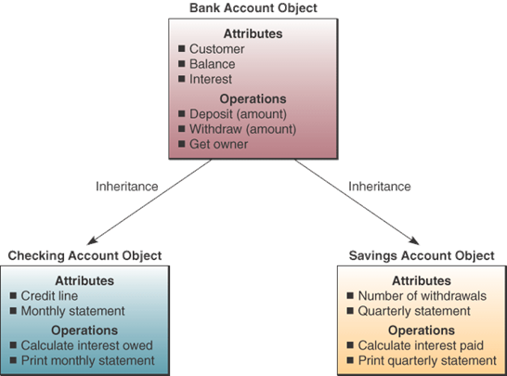
Object-oriented Structure
Source: Adapted from Ivar Jacobsen, Maria Ericsson, and Ageneta Jacobsen, The Object Advantage: Business Process
Reengineering with Object Technology (New York: ACM Press, 1995), p. 65.
Copyright @ 1995, Association for Computing Machinery. By permission.

Slide 17
Object-oriented Structure
Used in Object-oriented database management systems (OODBMS)
Supports complex data types
  Examples, graphic images, video clips, web pages

Slide 18
Evaluation of Database Structures
Hierarchical
  Worked for structured routine transaction processing
  Can’t handle many-to-many relationships
Network
  More flexible than hierarchical
  Unable to handle ad hoc requests
Relational
  Easily respond to ad hoc requests
  Easier to work with and maintain
  Not as efficient or quick as hierarchical or network
Notes:
Gap in performance between relational and hierarchical and network is rapidly narrowing

Slide 19
Database Development
Database Administrator (DBA)
  In charge of enterprise database development
Data Definition Language (DDL)
  Develop and specify the data contents, relationships and structure
  These specifications are stored in data dictionary
Data dictionary
  Data base catalog containing metadata
  Metadata – data about data

Slide 20
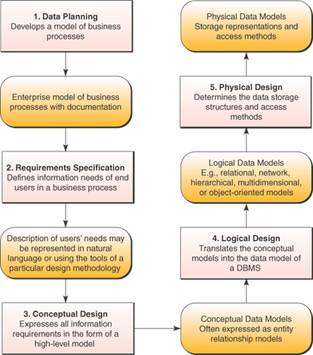
Database Development

Slide 21
Data Planning Process
Enterprise Model
  Defines basic business process of the enterprise
  Defined by DBAs and designers with end users
Data Modeling
  Relationships between data elements
  Entity Relationship Diagram (ERD) common tool for modeling

Slide 22
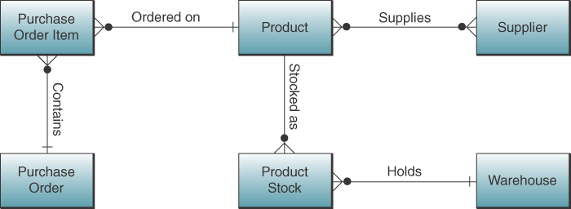
Entity Relationship Diagram

Slide 23
Database Design Process
Logical design
  Schema – overall logical view of relationships
  Subschema – logical view for specific end users
  Data models for DBMS
Physical design
  How data are to be stored and accessed on storage devices

Slide 24
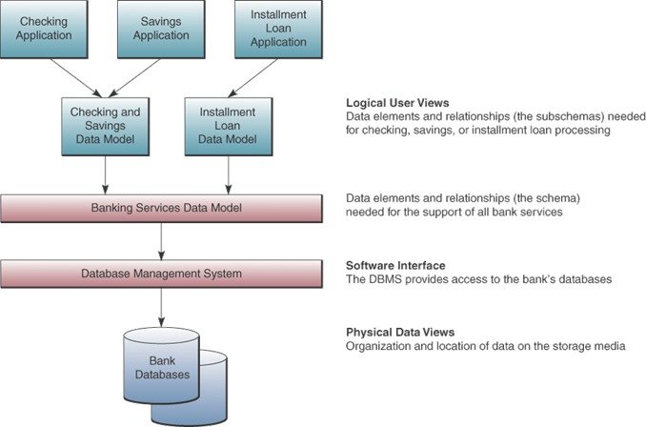
Logical and Physical Database Views

Slide 25
Data Resource Management
Managerial activity
Applies IS technologies like data management and data warehousing to manage data resources to meet the information needs of business stakeholders

Slide 26
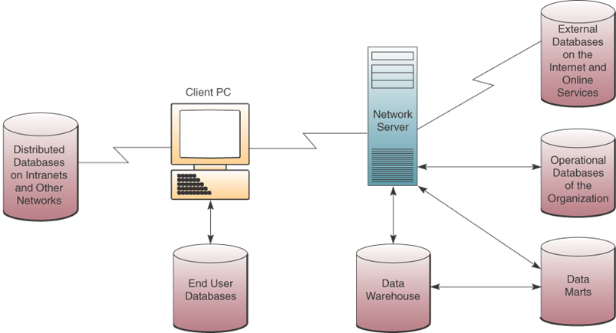
Types of databases

Slide 27
Operational Databases
Store detailed data to support business processes
Examples, customer database, inventory database

Slide 28
Distributed Databases
Copies or parts of databases on servers at a variety of locations
Challenge: any data change in one location must be made in all other locations
Replication:
  Look at each distributed database and find changes
  Apply changes to each distributed database
  Very complex
Duplication
  One database is master
  Duplicate that database after hours in all locations
  Easier

Slide 29
External Databases
Databases available for a fee from commercial online services or
For free from World Wide Web
Examples, statistical databanks, bibliographic and full text databases

Slide 30
Hypermedia Database
Website database
Consists of hyperlinked pages of multimedia (text, graphics, video clips, audio segments)

Slide 31
Data Warehouse
Stores data that has been extracted from the operational, external and other databases
Data has been cleaned, transformed and cataloged
Used by managers and professionals for
  Data mining,
  Online analytical processing,
  Business analysis,
  Market research,
  Decision support
Data mart is subset of warehouse for specific use of department

Slide 32
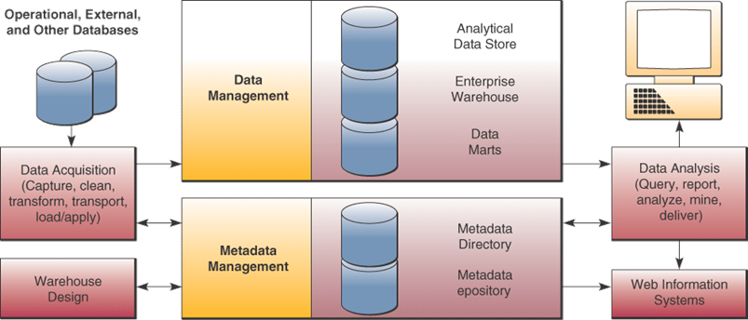
Data Warehouse
Source: Adapted courtesy of Hewlett-Packard.

Slide 33
Data Mining
Data in data warehouse are analyzed to reveal hidden patterns and trends
Examples:
  Perform market-basket analysis to identify new business processes
  Find root causes to quality problems
  Cross sell to existing customers
  Profile customers with more accuracy
Notes:
Discussed in more detail in chapter 9

Slide 34
Traditional File Processing
Data stored in independent files
Problems:
  Data redundancy
  Lack of data integration
  Data dependence – files, storage devices, and software are dependent on each other
  Lack of data integrity or standardization
Notes:
Traditional file processing leads to not being able to find data because it’s in multiple files. Or it’s too costly to combine and clean.
Data redundancy – duplicated data in several files
Data is not integrated across files.
Data dependence – software had references to format of data. So maintenance was difficult.
Inconsistency across files.
Problems resolved with Database Management Approach

Slide 35
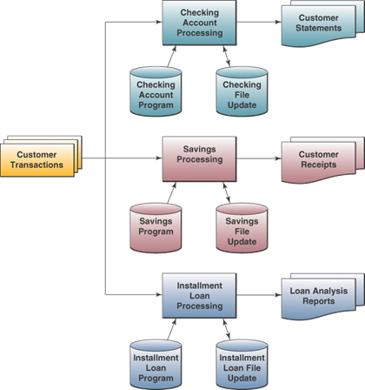
Traditional File Processing

Slide 36
Database Management Approach
Consolidate data into databases that can be accessed by different programs
Use a database management system (DBMS)
DBMS serves as interface between users and databases

Slide 37
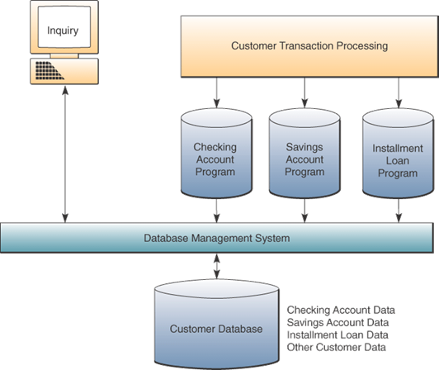
Database Management Approach

Slide 38
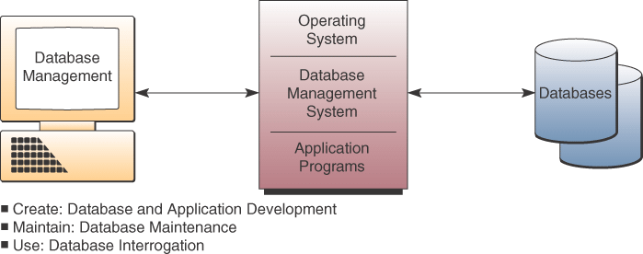
DBMS Major Functions

Slide 39
Database Interrogation
End users use a DBMS by asking for information via a query or a report generator
Query language – immediate responses to ad hoc data requests
  SQL (Structured Query Language) an international standard query language
  Graphical Queries -- Point-and-click methods
  Natural Queries – similar to conversational English
Report generator – quickly specify a report format for information you want printed in a report
Notes:
Database interrogation is major advantage of DBMS approach
SQL is pronounced Sequel

Slide 40
Database Maintenance
Updating database to reflect new business transactions such as a new sale
Done by transaction processing systems with support of DBMS

Slide 41
Application Development
Use DBMS software development tools to develop custom application programs
Data Manipulation Language (DML)

